Slide 1
EE1004
Graph
Andrew Leung : eeleungc@cityu.edu.hk
Whatsapp 852-90872682

Slide 2
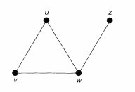
Graph
A simple graph G={V,E} consists of a non-empty finite set V(G) of elements called vertices (or nodes), and a finite set E(G) of distinct unordered pairs of distinct elements of V(G) called edges.
V(G): vertex set
E(G): the edge set.
An edge {v, w} is said to join the vertices v and w, and is usually abbreviated to vw.
Vertex set = {w, v, w, z},
Edge set = {uv, uw, vw, wz}
P

Slide 3
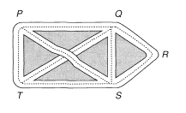
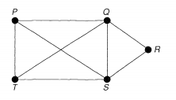
Brief Introduction of Graph
Representation example:
A road map :
The junction points P, Q, R, S and T => vertices, the roads => edges, and the whole diagram is called a graph.
Vertex set = {P, Q, R, S,T},
Edge set = { PQ, QR, RS, ST, PT, PS, QT, QS}
Note that the intersection of the lines PS and QT is not a vertex, since it does not correspond to a cross-roads
P

Slide 4
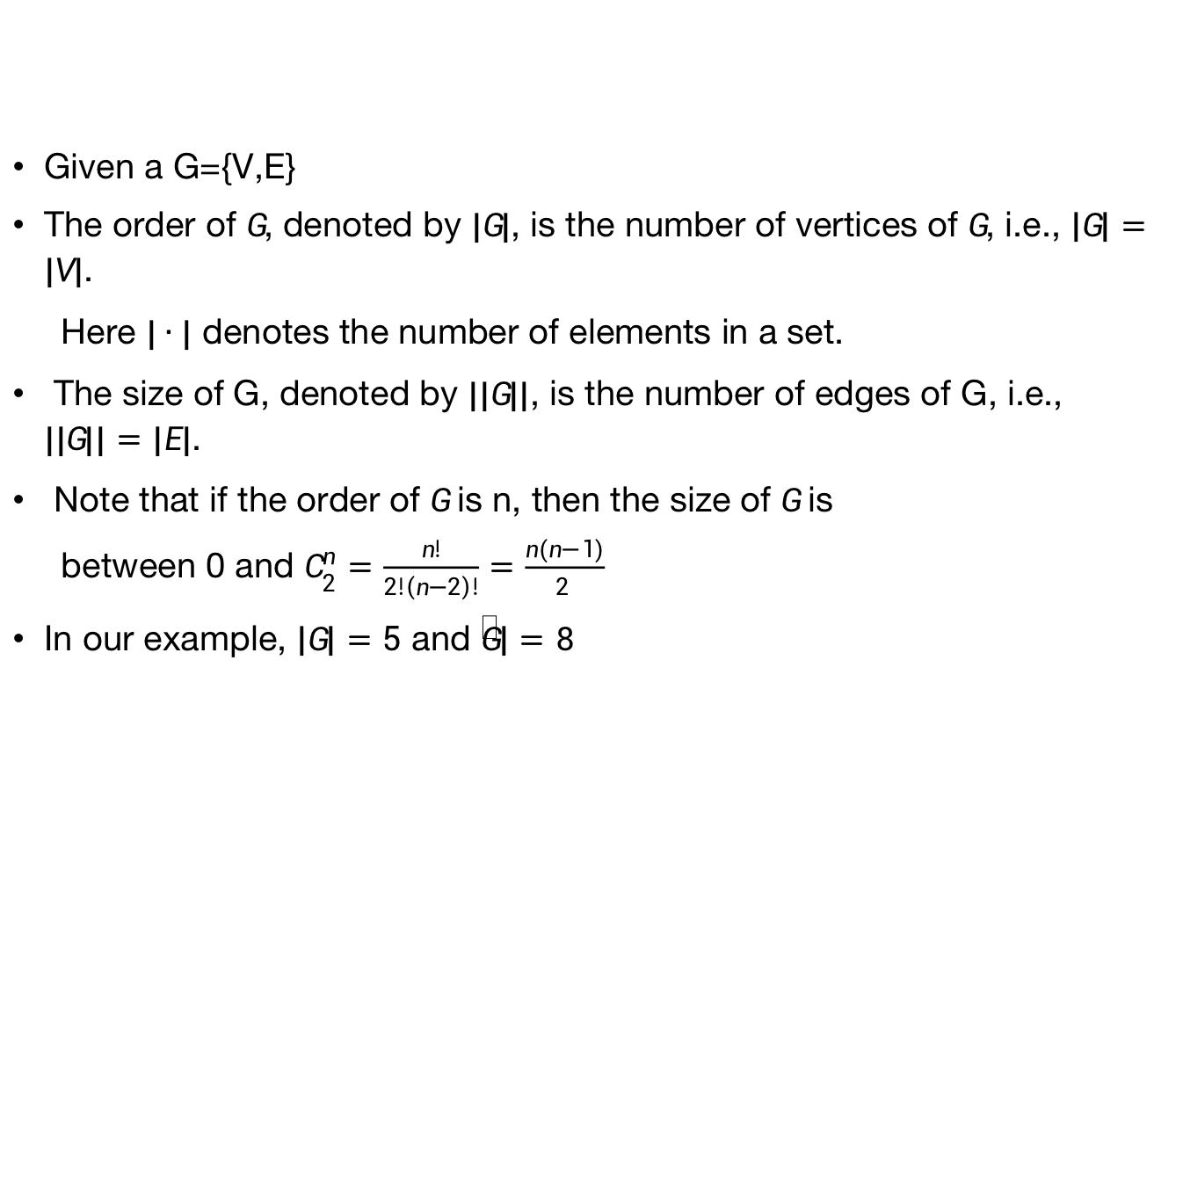
Brief Introduction of Graph (order and size)
Given a G={V,E}
The order of $G$, denoted by $|G|$, is the number of vertices of $G$, i.e., $\left|G\right|=|V|$.
Here $|∙|$ denotes the number of elements in a set.
The size of G, denoted by $||G||$, is the number of edges of G, i.e., $\left||G|\right|=|E|$.
Note that if the order of $G$ is n, then the size of $G$ is
between 0 and $C_{2}^{n}=\frac{n!}{2!\left(n−2\right)!}=\frac{n(n−1)}{2 }$
In our example, $\left|G\right|=5$ and $\left\|G\right\|=8$
P

Slide 5
Brief Introduction of Graph (degree)
The degree of a vertex is the number of edges with that vertex as an end-point;
The degree of Q=4.
The degree of R= ?
:
P

Slide 6
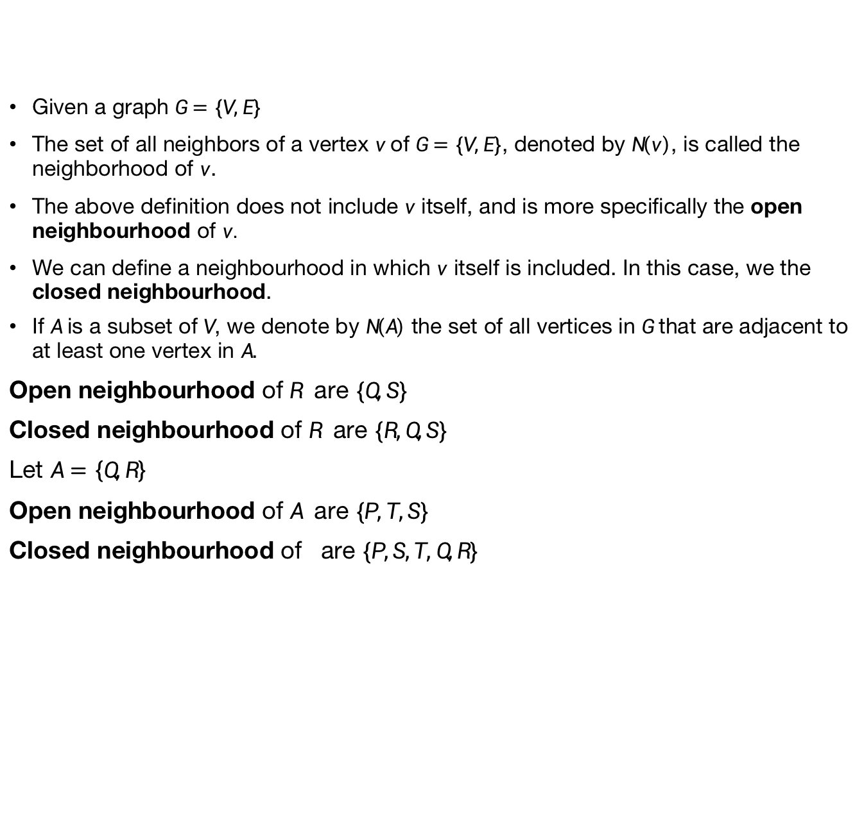
Brief Introduction of Graph (neighbourhood)
Given a graph $G=\{V,E\}$
The set of all neighbors of a vertex $v$of $G=\{V,E\}$, denoted by $N\left(v\right)$, is called the neighborhood of $v$.
The above definition does not include $v$ itself, and is more specifically the open neighbourhood of $v.$
We can define a neighbourhood in which $v$ itself is included. In this case, we the closed neighbourhood.
If $A$ is a subset of $V$, we denote by $N\left(A\right)$ the set of all vertices in $G$ that are adjacent to at least one vertex in $A$.
Open neighbourhood of $R$ are $\{Q,S\}$
Closed neighbourhood of $R$ are $\{R,Q,S\}$
Let $A=\left\{Q,R\right\}$
Open neighbourhood of $A$ are $\{P,T,S\}$
Closed neighbourhood of are $\{P,S,T,Q,R\}$
P

Slide 7
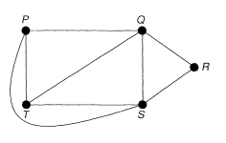
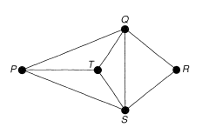
Brief Introduction of Graph (identical and isomorphic)
Remove the 'crossing' of the lines PS and QT by drawing the line PS outside the rectangle PQST.
The resulting graph still tells us whether there is a direct road from one intersection to another.
A graph is a representation of a set of points and of how they are joined up.
The way that we draw is irrelevant.
All the graphs are the same.
P

Slide 8
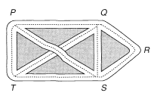
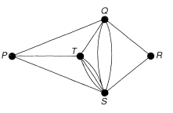
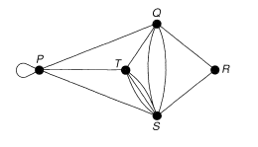
Brief Introduction of Graph (multiple edges and loop)
Suppose that the roads joining Q and S, and S and T, have too much traffic to carry.
Build extra roads joining these points.
The edges joining Q and S, or S and T, are called multiple edges.
Now we need a car park at P, then we indicate this by drawing an edge from P to itself, called a loop.
In general, a graph may contain loops and multiple edges.
Graphs with no loops or multiple edges are called simple graphs.
P

Slide 9
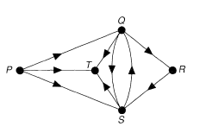
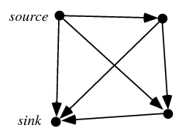
Brief Introduction of Graph (directed graphs)
The study of directed graphs (or digraphs, as we abbreviate them) arises from making the roads into one-way streets.
V is a set whose elements are called vertices, nodes, or points;
A is a set of ordered pairs of vertices, called arrows, directed edges (sometimes simply edges with the corresponding set named E instead of A), directed arcs, or directed lines.
For example, an arc (x, y) is considered to be directed from x to y.
P

Slide 10
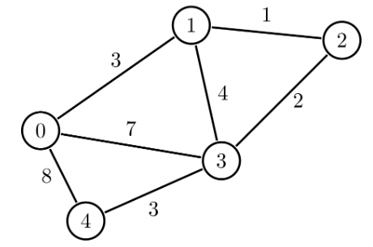
Brief Introduction of Graph (weighted graphs)
A weighted graph is a graph in which each branch is given a numerical weight.
A weighted graph is therefore a special type of labeled graph in which the labels are numbers (which are usually taken to be positive).
Weighted graphs are often used to model real objects and processes. For example, the graph above can be considered as a map, where the nodes are cities and the edges are roads. The weight of each edge is the distance between two cities.
P

Slide 11
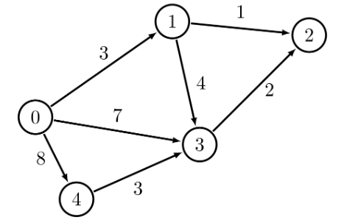
Brief Introduction of Graph (weighted graphs)
A directed weighted graph is a directed graph in which each branch is given a numerical weight.
Weighted directed graphs also can be used to model some real processes.
In our example, Node 0 can be considered as a storage place, from where we need to transfer some resources to the destination point, say to Node 2.
The remaining nodes can be considered as intermediate places.
Each edge shows a direction in which the resources can be transferred.
The weight of an edge shows the maximum amount of resources that can be sent through the edge.
P

Slide 12
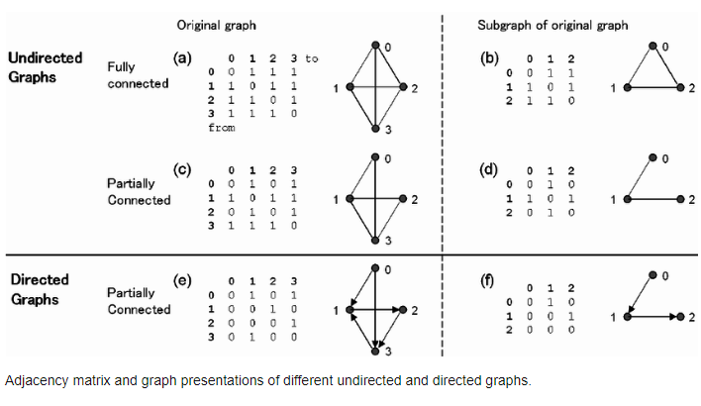

Brief Introduction of Graph (adjacency array (matrix) and incidence array (matrix))
If $G$ is a graph with vertices labelled $\{1,2,……, n\}$, its adjacency array $A$ is the n x n array whose $ij$-th entry is the number of edges (or the weight of the edge) joining vertex $i$ and vertex $j$.
P

Slide 13
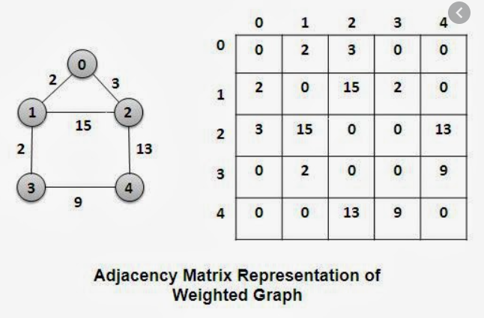
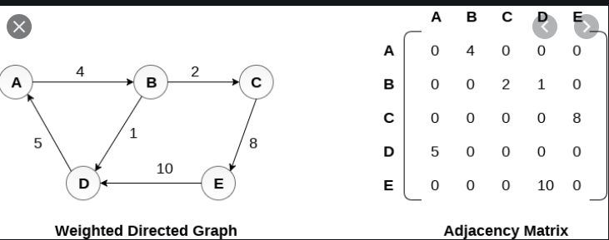
Brief Introduction of Graph (adjacency array (matrix) and incidence array (matrix))
If $G$ is a graph with vertices labelled $\{1,2,……, n\}$, its adjacency array $A$ is the n x n array whose $ij$-th entry is the number of edges (or the weight of the edge) joining vertex $i$ and vertex $j$.
P

Slide 14
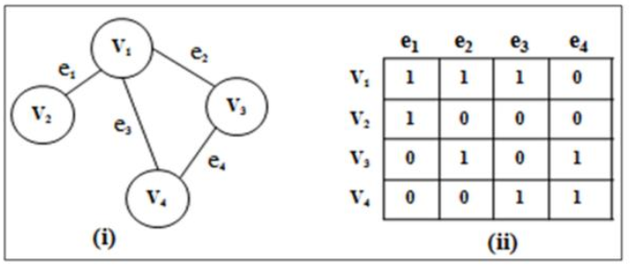

Brief Introduction of Graph (adjacency array (matrix) and incidence array (matrix))
$n$ nodes and $m$ edges
Its incidence array $M$ is the n x m array whose $ij$-th entry is 1 if vertex $i$ is incident to edge; and 0 otherwise.
P

Slide 15
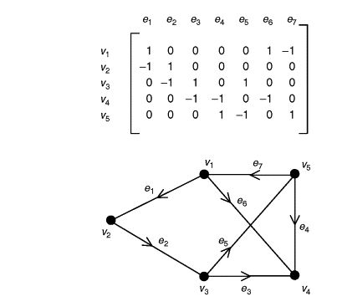
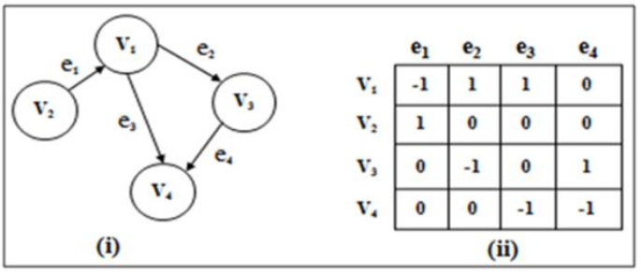

Brief Introduction of Graph (adjacency array (matrix) and incidence array (matrix))
$n$ nodes and $m$ edges
Its incidence array $M$ is a n × m 2D array
The $ij$-th entry of $M$ is 1, the $j$-th edge leaves the $i$-th node.
The $ij$-th entry of $M$ is -1, the $j$-th edge entries the $i$-th node.
(Note that some authors use opposite sign notation)
P

Slide 16
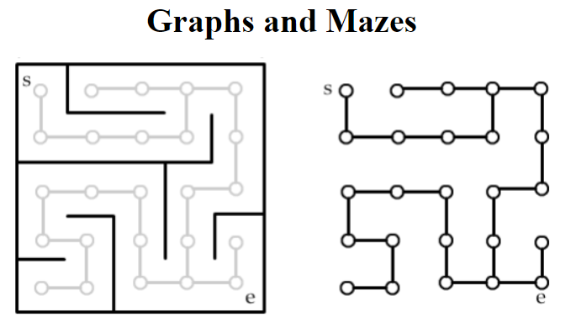
Brief Introduction of Graph (Some problems and Solutions)
A maze as a graph.
Each room in the maze is viewed as a vertex.
We add edges to the graph between adjacent rooms that are not blocked by a wall.
Find a shortest path from s to w. ???
It is the shortest path problem.
P

Slide 17
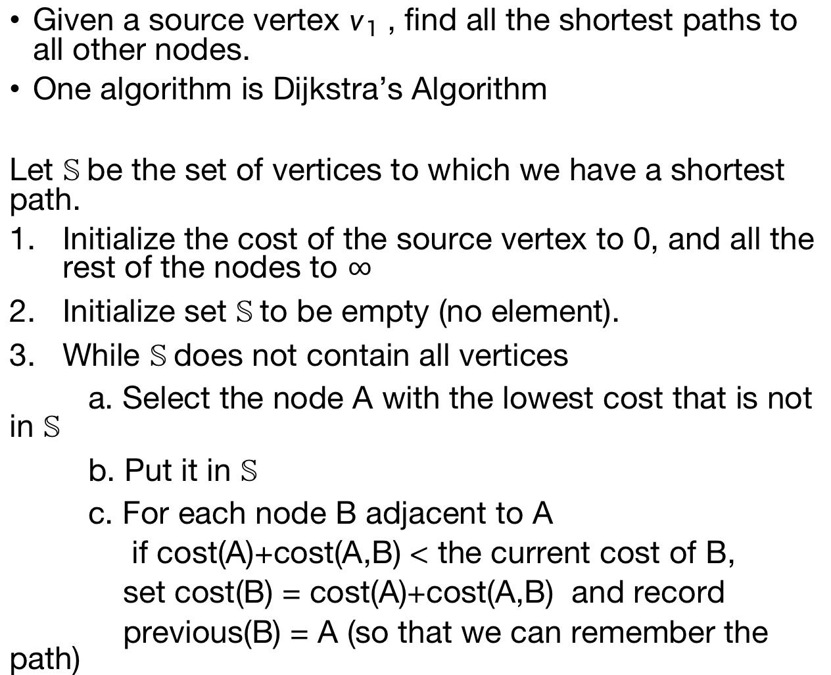
Brief Introduction of Graph (shortest path)
Given a source vertex $v_{1}$ , find all the shortest paths to all other nodes.
One algorithm is Dijkstra’s Algorithm
Let $𝕊$ be the set of vertices to which we have a shortest path.
Initialize the cost of the source vertex to 0, and all the rest of the nodes to $∞$
Initialize set $𝕊$ to be empty (no element).
While $𝕊$ does not contain all vertices
a. Select the node A with the lowest cost that is not in $𝕊$
b. Put it in $𝕊$
c. For each node B adjacent to A
if cost(A)+cost(A,B) < the current cost of B,
set cost(B) = cost(A)+cost(A,B) and record
previous(B) = A (so that we can remember the path)
P

Slide 18
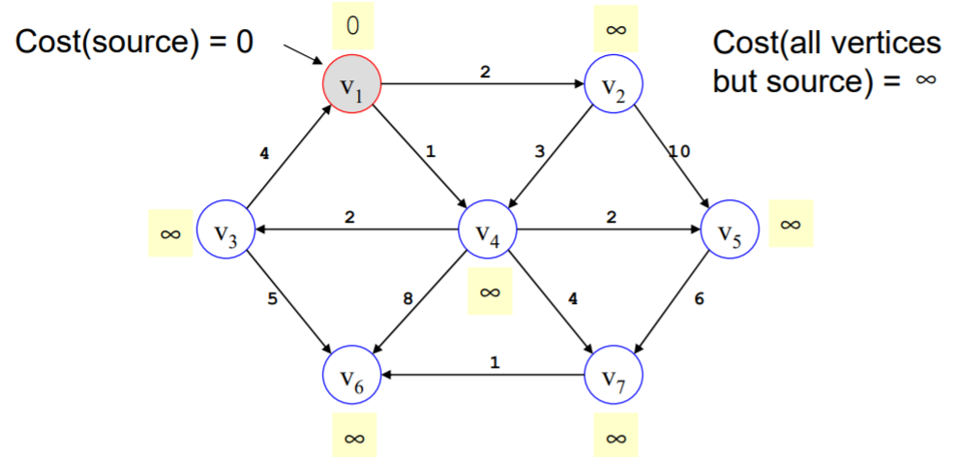

Brief Introduction of Graph (shortest path)
Example
Since ${C(v}_{1})=0,$ put $v_{1}$ to $𝕊$
$𝕊=\left\{v_{1}\right\}$, previous($v_{1}$) = Nil
P

Slide 19
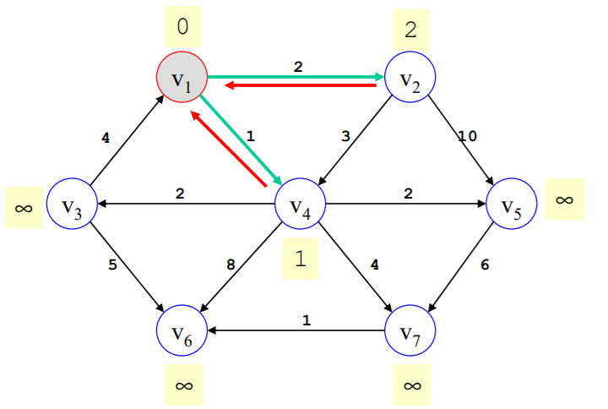
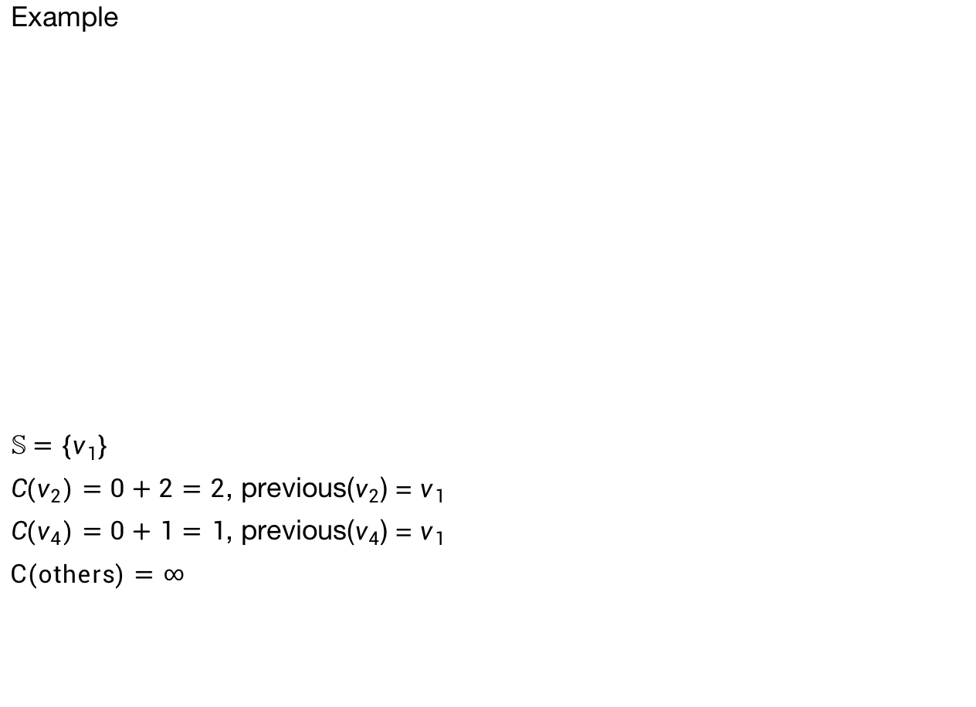
Brief Introduction of Graph (shortest path)
Example
$𝕊=\left\{v_{1}\right\}$
${C(v}_{2})=0+2=2$, previous($v_{2}$) = $v_{1}$
${C(v}_{4})=0+1=1$, previous($v_{4}$) = $v_{1}$
$C(others)=$ $∞$
P

Slide 20
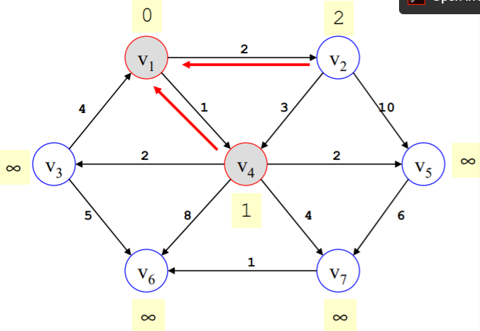
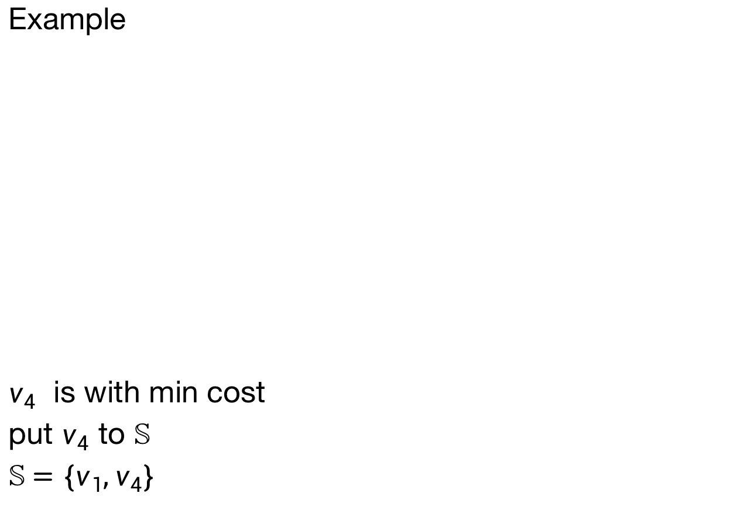
Brief Introduction of Graph (shortest path)
Example
$v_{4}$ is with min cost
put $v_{4}$ to $𝕊$
$𝕊=\left\{v_{1},v_{4}\right\}$
P

Slide 21
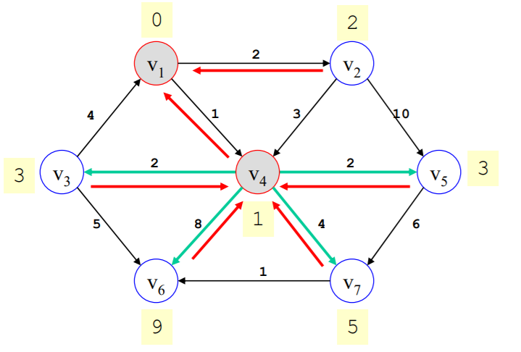
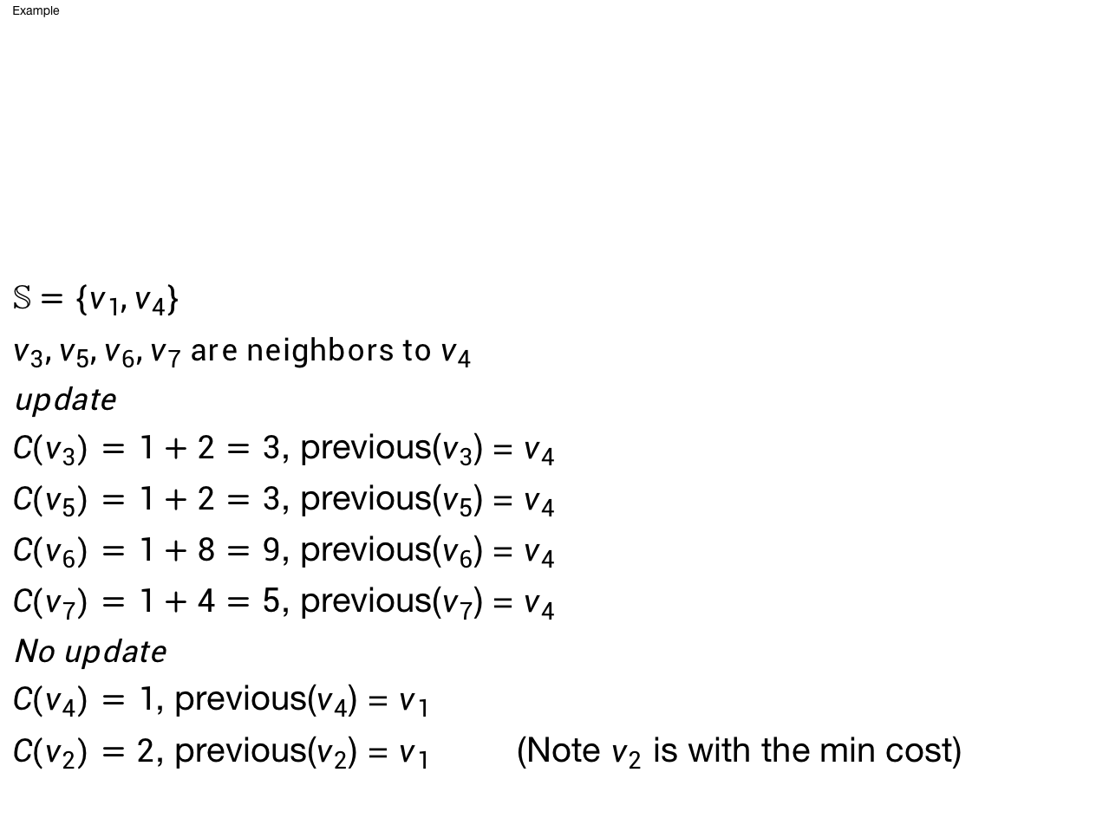
Brief Introduction of Graph (shortest path)
Example
$𝕊=\left\{v_{1},v_{4}\right\}$
$v_{3},v_{5},v_{6},v_{7}$ are neighbors to $v_{4}$
update
${C(v}_{3})=1+2=3$, previous($v_{3}$) = $v_{4}$
${C(v}_{5})=1+2=3$, previous($v_{5}$) = $v_{4}$
${C(v}_{6})=1+8=9$, previous($v_{6}$) = $v_{4}$
${C(v}_{7})=1+4=5$, previous($v_{7}$) = $v_{4}$
No update
${C(v}_{4})=1$, previous($v_{4}$) = $v_{1}$
${C(v}_{2})=2$, previous($v_{2}$) = $v_{1}$ (Note $v_{2}$ is with the min cost)
P

Slide 22
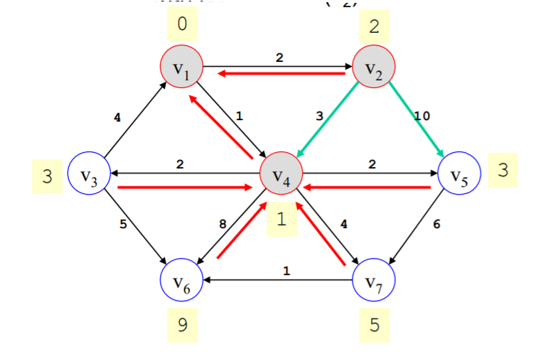
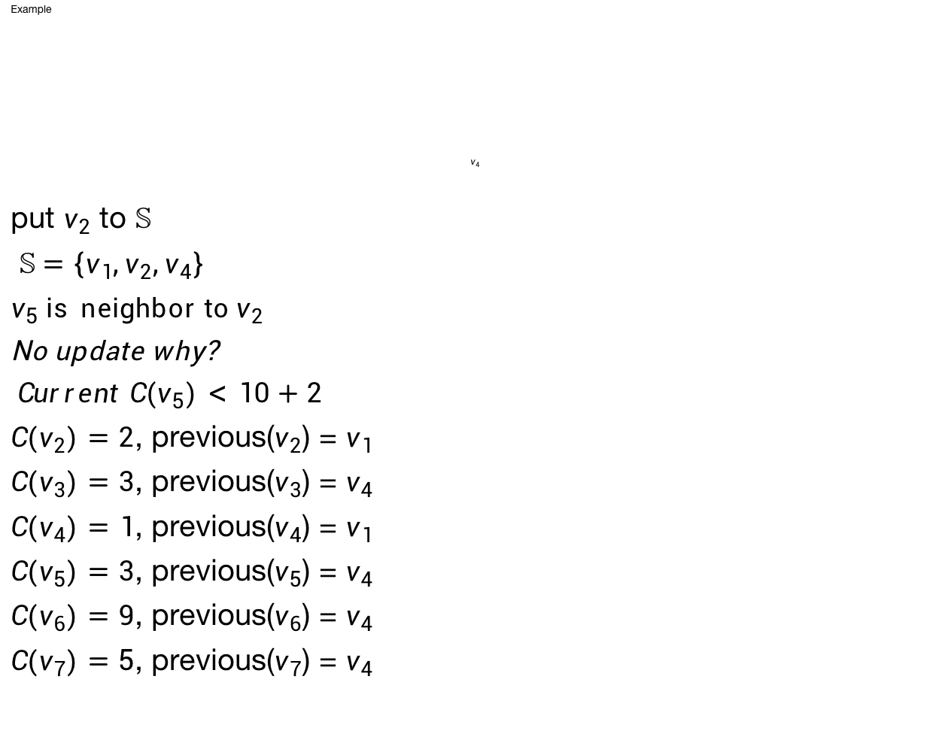
Brief Introduction of Graph (shortest path)
Example
$$v_{4}$$
put $v_{2}$ to $𝕊$
$𝕊=\left\{v_{1},v_{2},v_{4}\right\}$
$v_{5}$ is neighbor to $v_{2}$
No update why?
${Current C(v}_{5})<10+2$
${C(v}_{2})=2$, previous($v_{2}$) = $v_{1}$
${C(v}_{3})=3$, previous($v_{3}$) = $v_{4}$
${C(v}_{4})=1$, previous($v_{4}$) = $v_{1}$
${C(v}_{5})=3$, previous($v_{5}$) = $v_{4}$
${C(v}_{6})=9$, previous($v_{6}$) = $v_{4}$
${C(v}_{7})=5$, previous($v_{7}$) = $v_{4}$
P

Slide 23
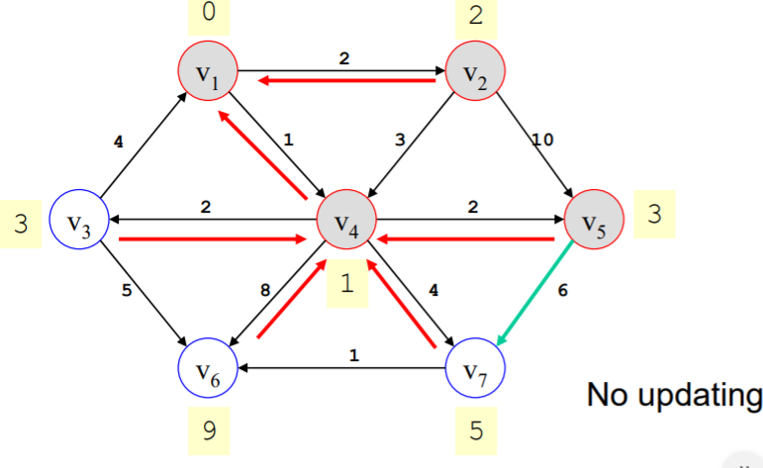
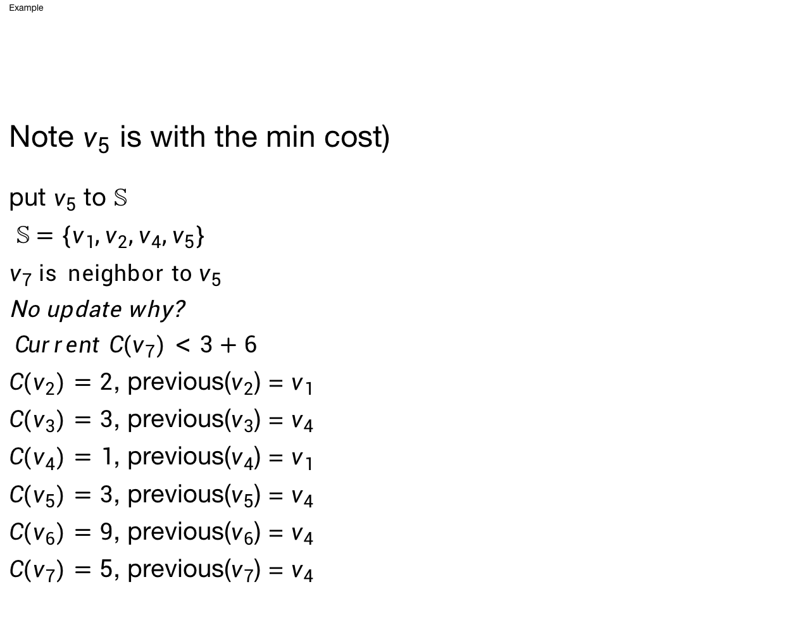
Brief Introduction of Graph (shortest path)
Example
Note $v_{5}$ is with the min cost)
put $v_{5}$ to $𝕊$
$𝕊=\left\{v_{1},v_{2},v_{4},v_{5}\right\}$
$v_{7}$ is neighbor to $v_{5}$
No update why?
${Current C(v}_{7})<3+6$
${C(v}_{2})=2$, previous($v_{2}$) = $v_{1}$
${C(v}_{3})=3$, previous($v_{3}$) = $v_{4}$
${C(v}_{4})=1$, previous($v_{4}$) = $v_{1}$
${C(v}_{5})=3$, previous($v_{5}$) = $v_{4}$
${C(v}_{6})=9$, previous($v_{6}$) = $v_{4}$
${C(v}_{7})=5$, previous($v_{7}$) = $v_{4}$
P

Slide 24
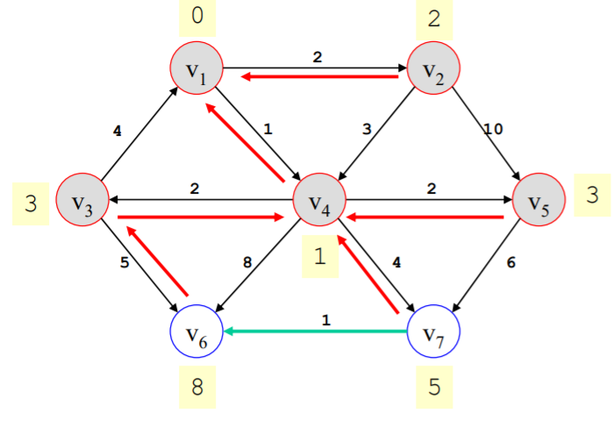
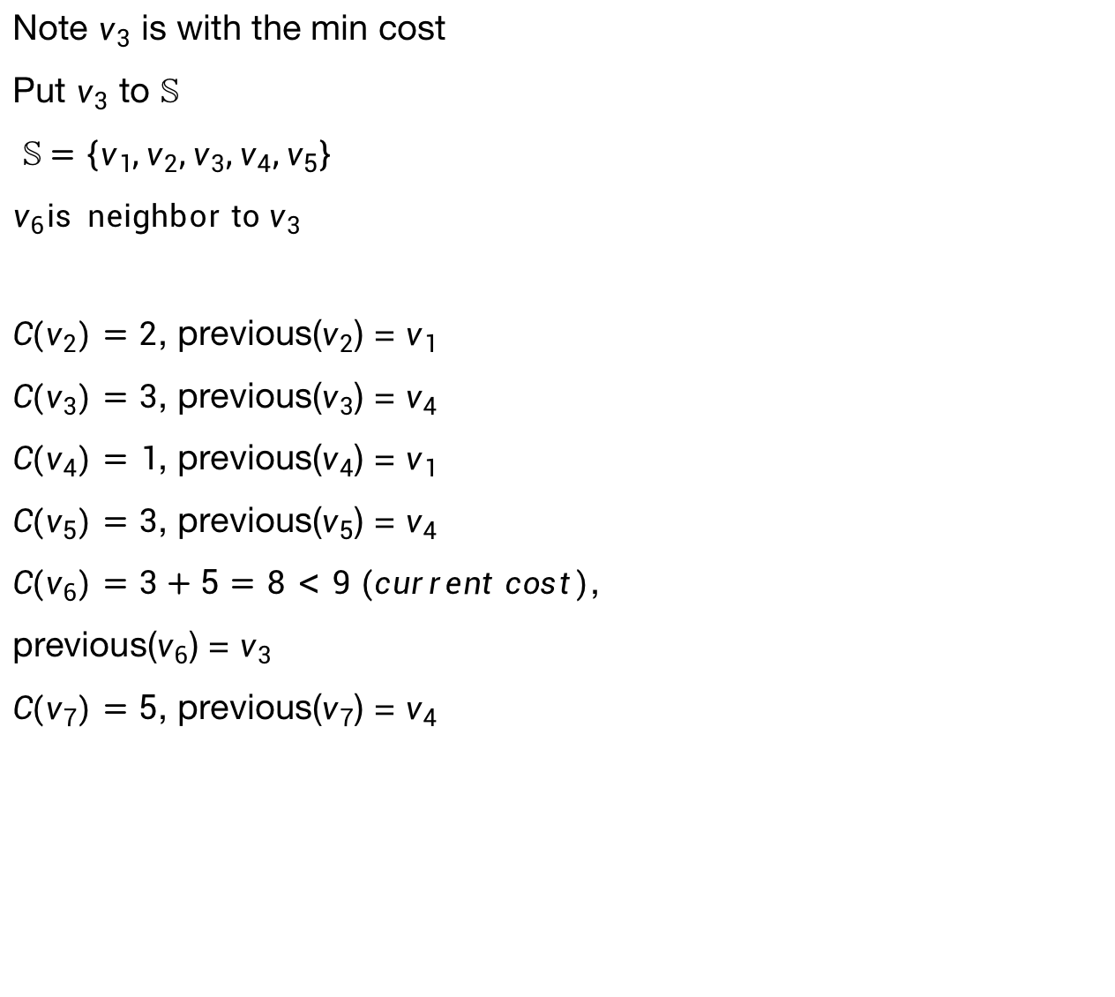
Brief Introduction of Graph (shortest path)
Note $v_{3}$ is with the min cost
Put $v_{3}$ to $𝕊$
$𝕊=\left\{v_{1},v_{2},v_{3},v_{4},v_{5}\right\}$
$v_{6}$is neighbor to $v_{3}$
${C(v}_{2})=2$, previous($v_{2}$) = $v_{1}$
${C(v}_{3})=3$, previous($v_{3}$) = $v_{4}$
${C(v}_{4})=1$, previous($v_{4}$) = $v_{1}$
${C(v}_{5})=3$, previous($v_{5}$) = $v_{4}$
${C(v}_{6})=3+5=8<9 (current cost)$,
previous($v_{6}$) = $v_{3}$
${C(v}_{7})=5$, previous($v_{7}$) = $v_{4}$
P

Slide 25
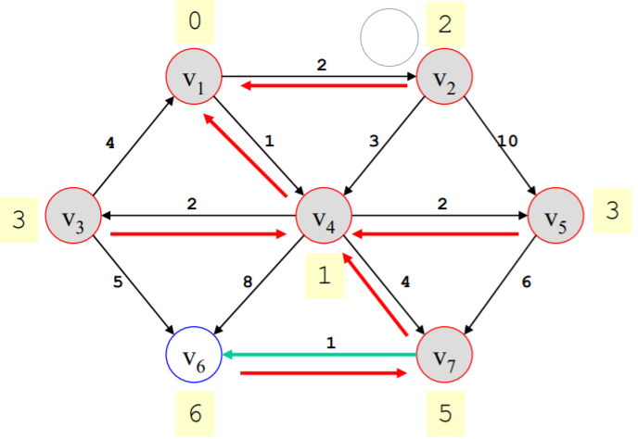
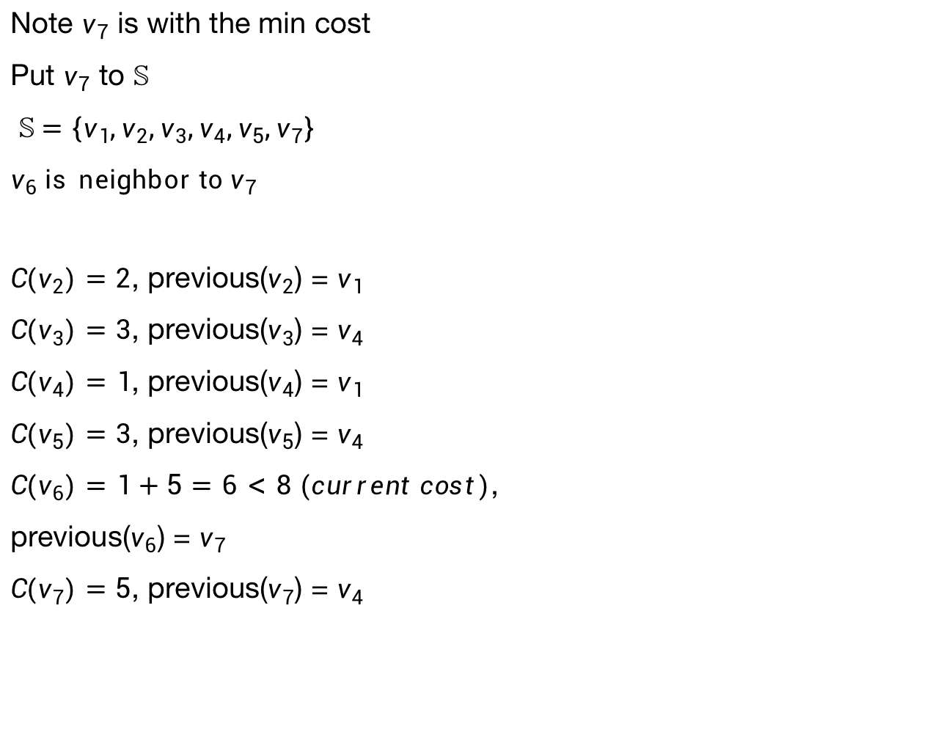
Brief Introduction of Graph (shortest path)
Note $v_{7}$ is with the min cost
Put $v_{7}$ to $𝕊$
$𝕊=\left\{v_{1},v_{2},v_{3},v_{4},v_{5},v_{7}\right\}$
$v_{6}$ is neighbor to $v_{7 }$
${C(v}_{2})=2$, previous($v_{2}$) = $v_{1}$
${C(v}_{3})=3$, previous($v_{3}$) = $v_{4}$
${C(v}_{4})=1$, previous($v_{4}$) = $v_{1}$
${C(v}_{5})=3$, previous($v_{5}$) = $v_{4}$
${C(v}_{6})=1+5=6<8 (current cost)$,
previous($v_{6}$) = $v_{7}$
${C(v}_{7})=5$, previous($v_{7}$) = $v_{4}$
P

Slide 26
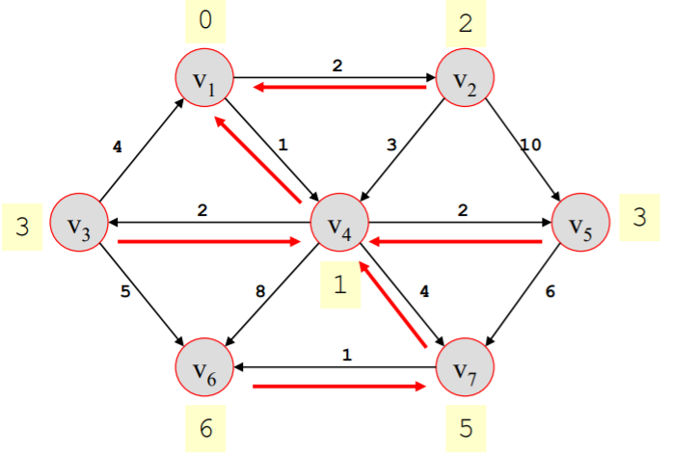

Brief Introduction of Graph (shortest path)
Put $v_{6}$ to $𝕊$
$𝕊=\left\{v_{1},v_{2},v_{3},v_{4},v_{5},v_{6}v_{7}\right\}$
${C(v}_{2})=2$, previous($v_{2}$) = $v_{1}$
${C(v}_{3})=3$, previous($v_{3}$) = $v_{4}$
${C(v}_{4})=1$, previous($v_{4}$) = $v_{1}$
${C(v}_{5})=3$, previous($v_{5}$) = $v_{4}$
${C(v}_{6})=6$, previous($v_{6}$) = $v_{7}$
${C(v}_{7})=5$, previous($v_{7}$) = $v_{4}$
P

Slide 27
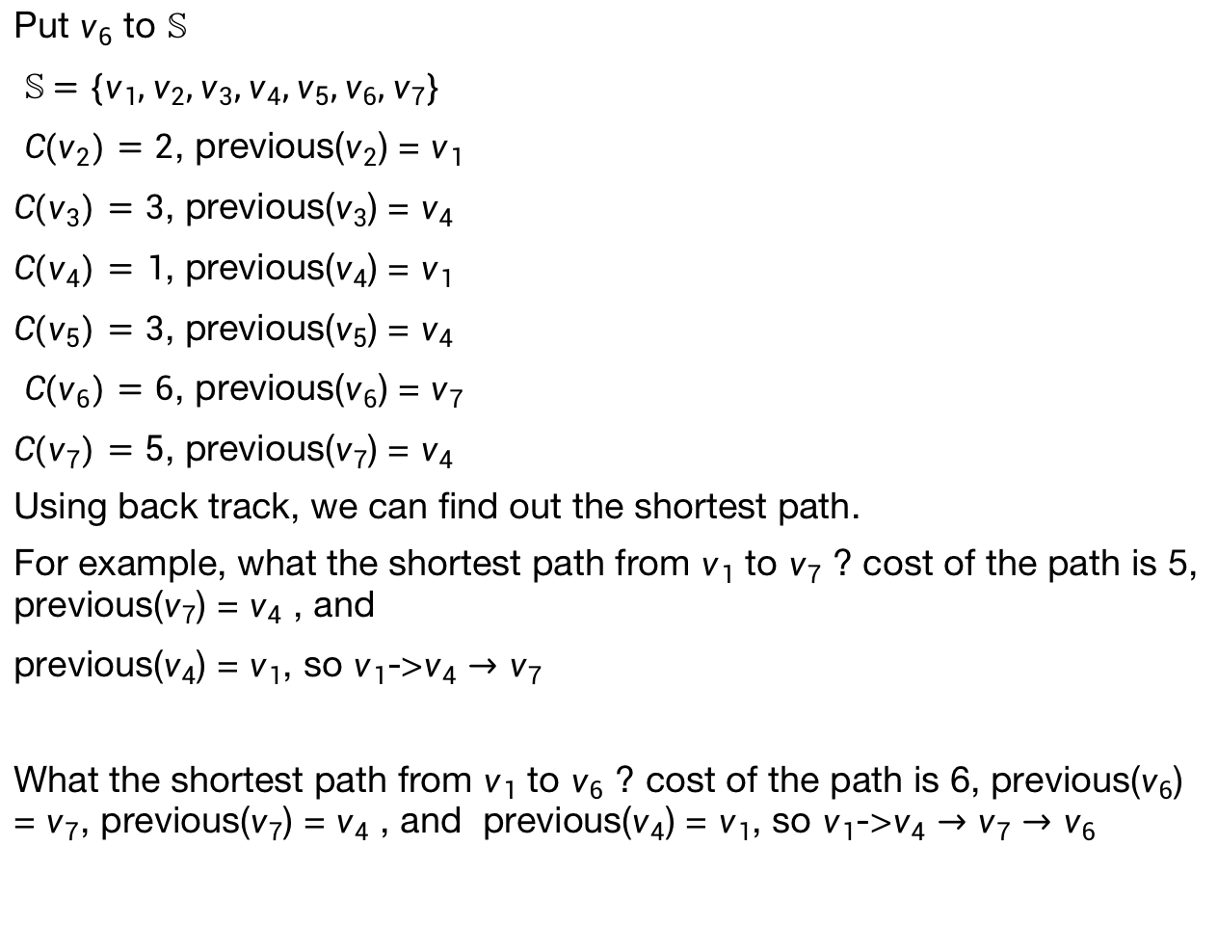
Brief Introduction of Graph (shortest path)
Put $v_{6}$ to $𝕊$
$𝕊=\left\{v_{1},v_{2},v_{3},v_{4},v_{5},v_{6}{,v}_{7}\right\}$
${C(v}_{2})=2$, previous($v_{2}$) = $v_{1}$
${C(v}_{3})=3$, previous($v_{3}$) = $v_{4}$
${C(v}_{4})=1$, previous($v_{4}$) = $v_{1}$
${C(v}_{5})=3$, previous($v_{5}$) = $v_{4}$
${C(v}_{6})=6$, previous($v_{6}$) = $v_{7}$
${C(v}_{7})=5$, previous($v_{7}$) = $v_{4}$
Using back track, we can find out the shortest path.
For example, what the shortest path from $v_{1}$ to $v_{7}$ ? cost of the path is 5, previous($v_{7}$) = $v_{4}$ , and
previous($v_{4}$) = $v_{1}$, so $v_{1}$->$v_{4}→v_{7}$
What the shortest path from $v_{1}$ to $v_{6}$ ? cost of the path is 6, previous($v_{6}$) = $v_{7}$, previous($v_{7}$) = $v_{4}$ , and previous($v_{4}$) = $v_{1}$, so $v_{1}$->$v_{4}→v_{7}→v_{6}$
P

